Slide 1
Introductory General Chemistry
Chemistry 3A
S. M. Halloran

Slide 2
Chemical Equilibrium
Collision Theory
Reaction Rates
Dynamic Equilibrium
The Equilibrium Constant
Le Chatelier’s Principle
Special Types of Equilibria

Slide 3
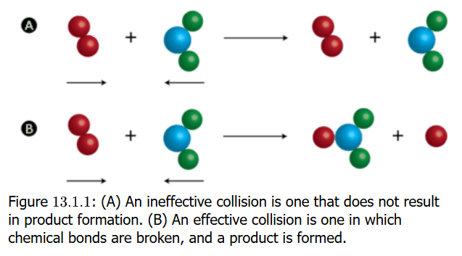
Collision Theory
Collision Theory: proposes that reactant particles colliding with each other form products but under two condition
That there is enough kinetic energy to cause a reaction
That particles are in a proper orientation for a reaction to occur

Slide 4
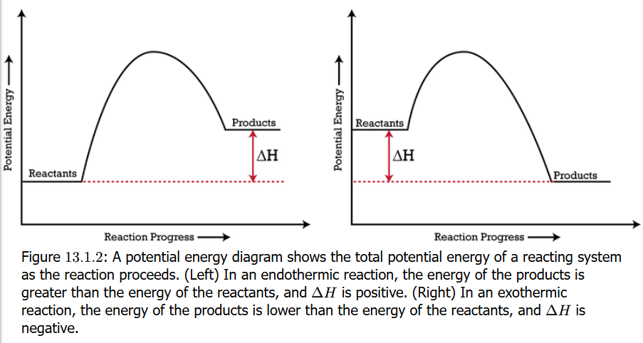
Potential Energy Diagrams
Also called reaction progress curve
Potential energy diagrams show change in potential energy of a system as the reactants become products
The energy change is shown by change in enthalpy ΔH
If ΔH > 0 (products higher than reactants), the reaction is endothermic. If ΔH < 0, the reaction is exothermic

Slide 5
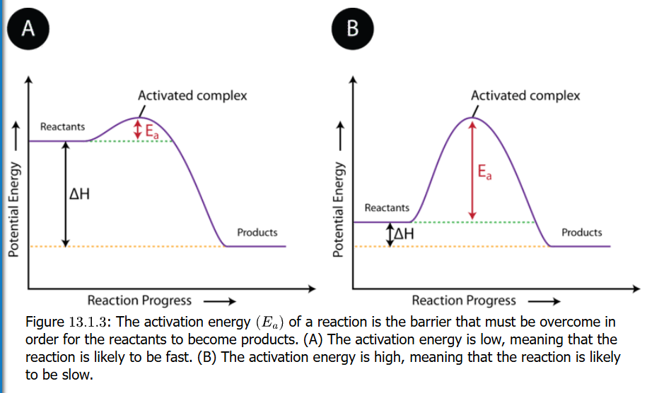
Activation Energy
Reactant particles will collide, but not all collisions result in the chemical reaction
But when collisions happen that have enough energy—activation energy—to occur, reactants will become products by forming an activated complex

Slide 6
E_{a} for Fast or Slow Reactions
The activation energy is symbolized as E_{a}
On the reaction progress curve, it is a “hump” in the curve representing the increase in energy above the PE of the reactants, whether the reaction is endo- or exothermic
If the hump is small, the reaction is likely to be fast. If hump is large, the reaction is likely to be slow

Slide 7
The Activated Complex
When collisions lead to reactions, an activated complex forms as unstable arrangement of atoms that exists momentarily at the peak of the activation energy barrier
The momentary part cannot be imagined how fast it is: 10^{–13} s (one-tenth of a picosecond). An eye blink is one tenth of a second, so the reaction in one trillion times faster (lasers can be used to determine time)

Slide 8
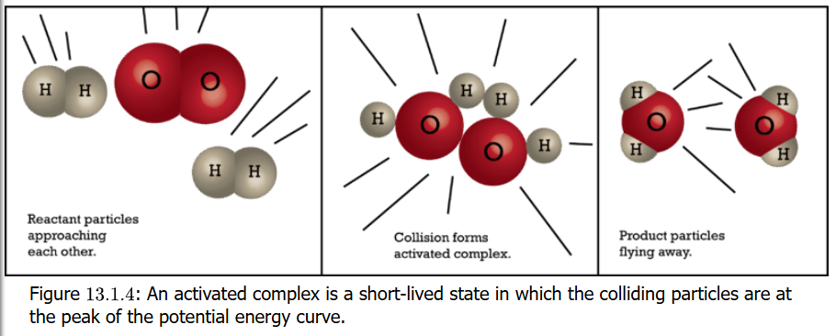
Activated Complex Note
A note about the provided text for the course:
Book shows this visual of a reaction of 2 H₂ + O₂ → 2 H₂O but that is absolutely not considered to be the mechanism of how this happens. The reaction is in fact a multi-step mechanism. The details are beyond scope of Chem 3A.

Slide 9
Reaction Rates Factors: Temperature
(i) Collision frequency, (ii) collision energy, and (iii) geometric orientation are factors in a successful reaction
Temperature affects collision frequency
Temperature affects average velocity, and velocity is a factor in kinetic energy. Particles collide more frequently
Temperature directly affects activation energy E_{a}
Keeping environments cold versus warm versus hot is understood to control chemical reactions that, for example, might lead to preservation or spoilage of food

Slide 10
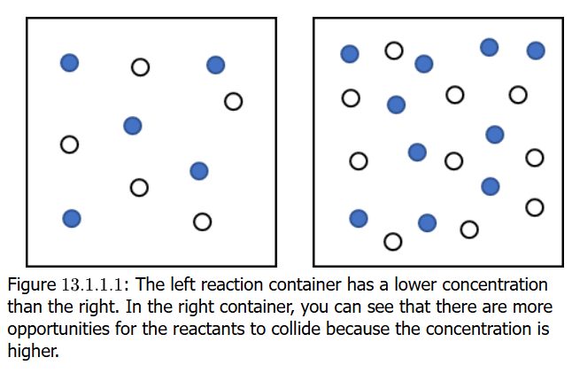
Concentration as a Factor
Reactions are also affected by concentration
Higher concentrations imply particles (molecules, etc) are closer together, more densely arranged, with a higher probability of collisions
If a concentration doubles, so would the reaction rate also double
Combustion involves a flammable substance and oxygen. If splint of wood set on fire and fire blown out, the splint continues to glow. If splint put in chamber with no O₂, the wood stops burning (glows dissipates). But if put in 100% O₂ chamber, it burns brighter and hotter. This affects shows concentration or reactants.

Slide 11
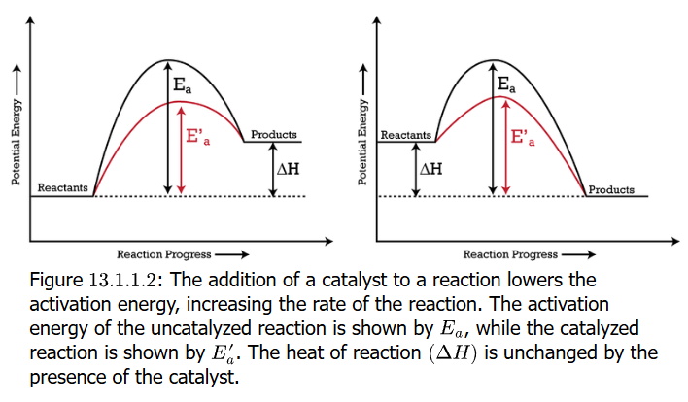
Catalysis and Catalysts
Catalysis is the process by which rate of chemical reaction is changed (usually increased) through the action of a catalyst
A catalyst is a substance that increases rate of a chemical reaction without being consumed or permanently altered in the overall reaction
The effect of catalysis is seen in the reaction progress curve as a lowering of the activation energy Ea, which enables reactants to get over the energy barrier in the reaction

Slide 12
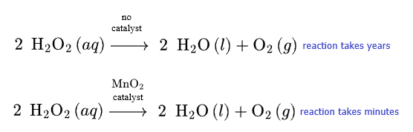
Catalysis Example
Hydrogen peroxide (H₂O₂) is a well-known effective disinfectant. A 3% solution stores well for a few years, but it eventually degrades to water and oxygen products
Just a small amount of manganese(IV) oxide (MnO₂) will accelerate the reaction to where it degrades within minutes

Slide 13
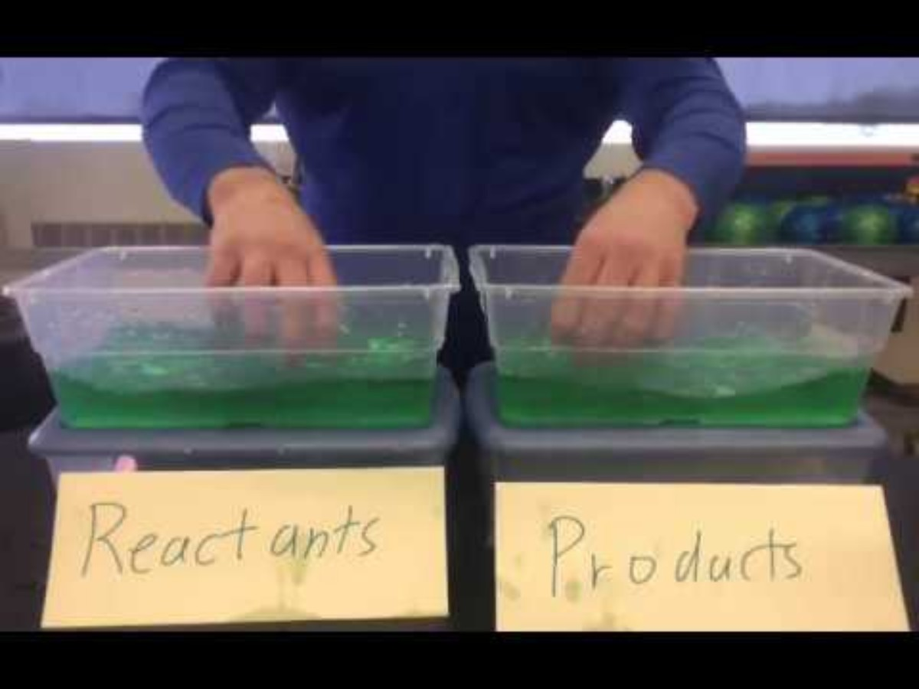
Chemical Equilibrium
Chemical reaction rates (kinetics) were addressed in the previous slides
This addresses the concept of chemical equilibrium, of reactants in initial conditions with no products, and of reactions showing products now becoming reactants in a reverse of the direction of the reaction

Slide 14

Reversible Reactions
The $⇌$ symbol/character was previously to indicate the state of equilibrium, the concept that chemical reactions often have a forward and reverse of the reaction
The formation and decomposition of hydroiodic acid (hydrogen iodide) [HI] is an example of the reaction going both ways
$$H2+I2→2 HI (forward) \\ 2 HI→H2+I2 (reverse)$$ $$H2+I2⇌2 HI$$

Slide 15
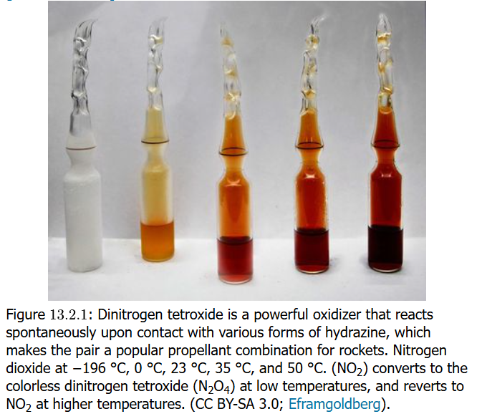

Dynamic Equilibrium
$$\left[colorless\right] N2O4 \left(g\right)⇌2 NO2 \left(g\right) \text{[}\text{red}\text{−}\text{brown}\text{]}$$
The forward and reverse directions of the reaction are shown
$$N2O4 \left(g\right)→2 NO2 (g)$$ $2 NO2 (g)$ $→N2O4 \left(g\right)$
N₂O₄ is colorless and NO₂ is reddish-brown so a reaction can be monitored visually
Note that the figure shows the temperature dependence on equilibrium: at lower temperatures the formation of reactant (N₂O₄) is favored, but at higher temperatures the products will be favored

Slide 16
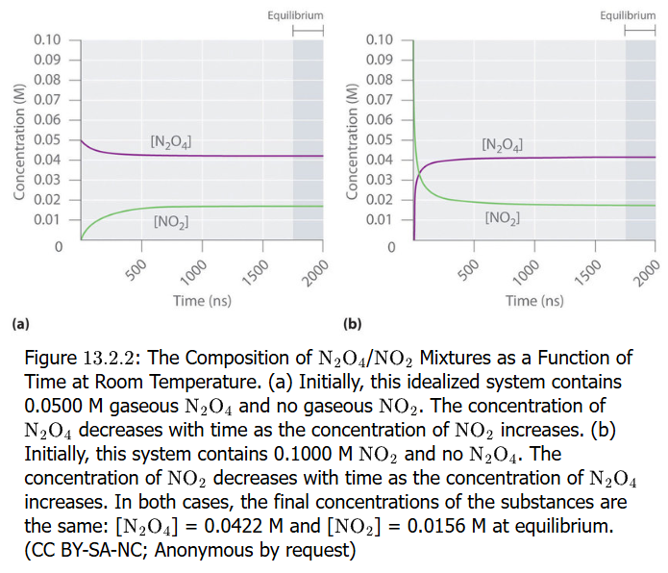
Example of Dynamic Equilibrium
Equilibrium is shown as the change in concentration of reactant and/or product over time
One can start with no (zero) concentration of product (for forward reaction) or of reactant (for reverse direction this become the product) and follow change in amount or concentration over time
Eventually a plateau is reached where concentration of neither reactant or product changes
This is equilibrium

Slide 17
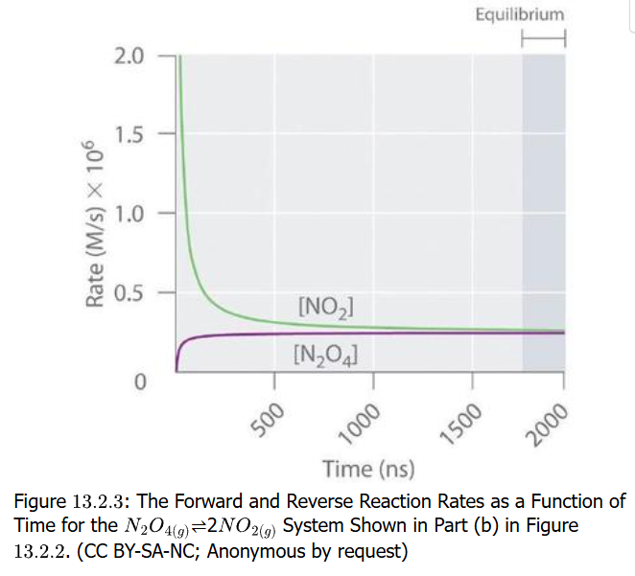
Change in Rate of Reaction
In the plot shown, it shows not amount or concentration, but rather the rate of the reaction versus time. A rate of reaction is the function of the concentration (molar, M) per unit time
Initially the sample is pure red-brown NO₂ and will form colorless N₂O₄
As N₂O₄ product forms, the rate slows and eventually levels off to a constant rate while the reverse reaction increases to a level rate as well

Slide 18

Rate of Reaction Equation
The (forward) reaction rate, which is the dimerization of NO₂, has a mathematical expression: $forward rate=\frac{d[NO2]}{dt}=kf\left[NO2\right]\left[NO2\right]=kf\left[NO2\right]2$
$$reverse rate=\frac{d[N2O4]}{dt}=kr\left[N2O4\right]$$
The details of rate equations are beyond the scope of this course but are mentioned here only because the textbook references these equations

Slide 19
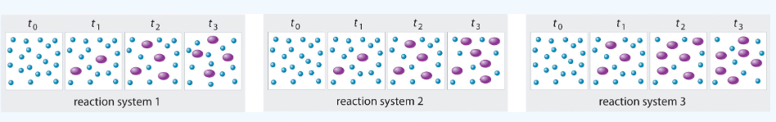

Practice: Equilibrium
In the illustrated three reaction systems, what is the relative time to reach chemical equilibrium where $2 A⇌B$? A=small blue dot, B = large purple dot
Systems 1 and 3 show A decrease from t₀ to t₂, with t₂ and t₃ having no change; thus at equilibrium by t₃
System 2: A and B still changing between t₂ and t₃, and this system may not have reached equilibrium

Slide 20
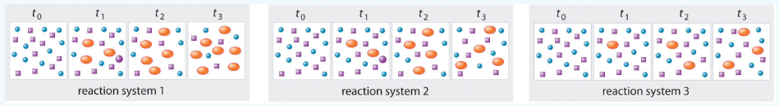

Practice: Equilibrium
Another three reaction systems shown, where $A+B⇌C$ which system(s) has reached equilibrium? A=blue circles, B = purple squares, C=orange ovals
System 2: the t₂ and t₃ time frames have 4 orange ovals and the count of the reactants should be same
The other systems would need to reflect no changes between the last two time frames to demonstrate equilibrium, and they do not.

Slide 21
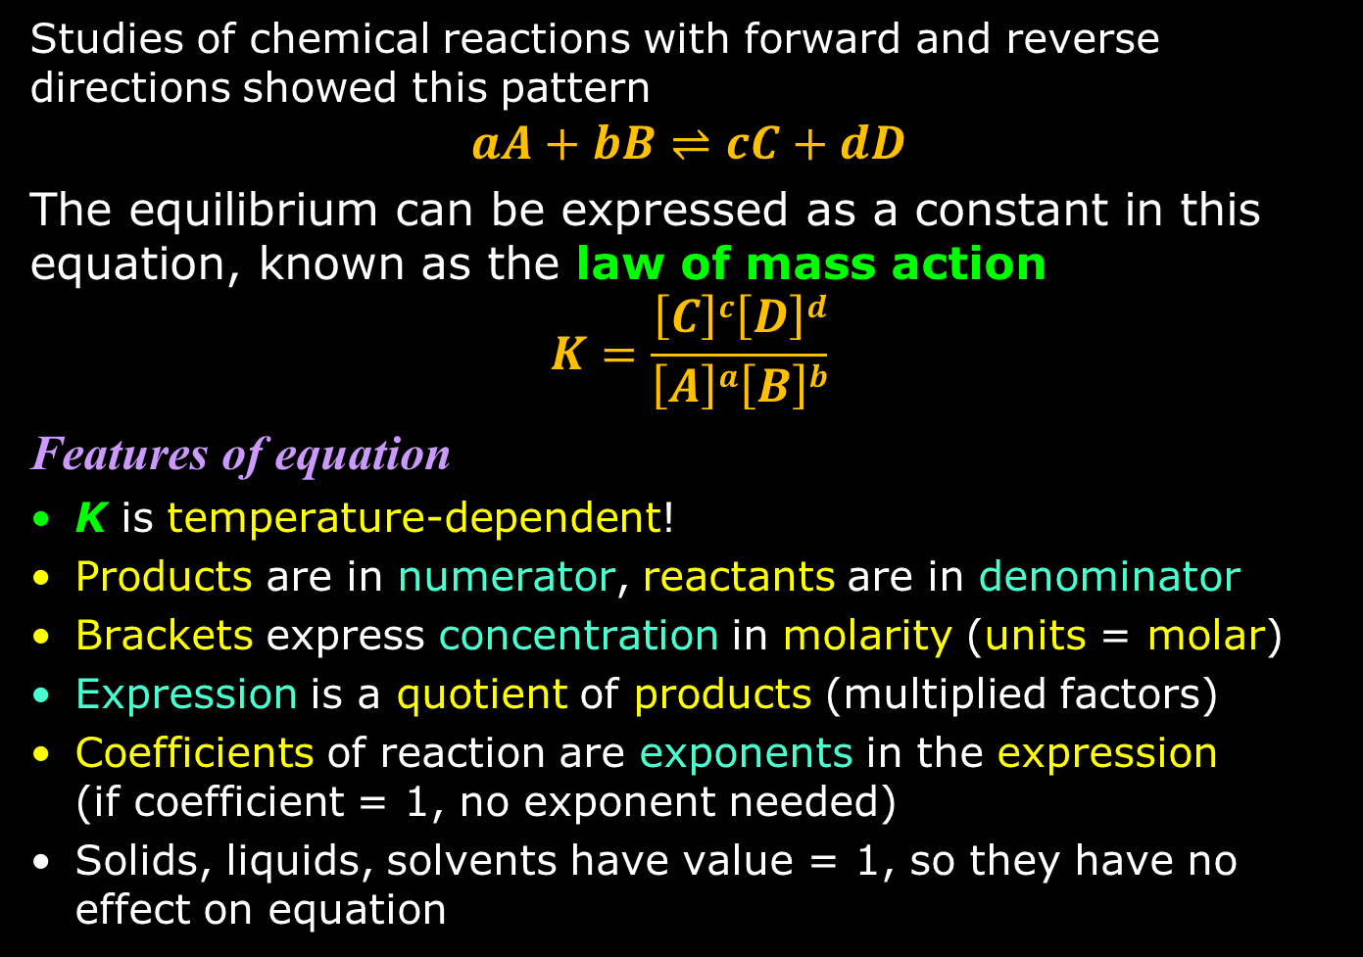
Equilibrium Constant Equation
Studies of chemical reactions with forward and reverse directions showed this pattern
$$aA+bB⇌cC+dD$$
The equilibrium can be expressed as a constant in this equation, known as the law of mass action
$$K=\frac{\left[C\right]c\left[D\right]d}{\left[A\right]a\left[B\right]b}$$
Features of equation
K is temperature-dependent!
Products are in numerator, reactants are in denominator
Brackets express concentration in molarity (units = molar)
Expression is a quotient of products (multiplied factors)
Coefficients of reaction are exponents in the expression (if coefficient = 1, no exponent needed)
Solids, liquids, solvents have value = 1, so they have no effect on equation

Slide 22
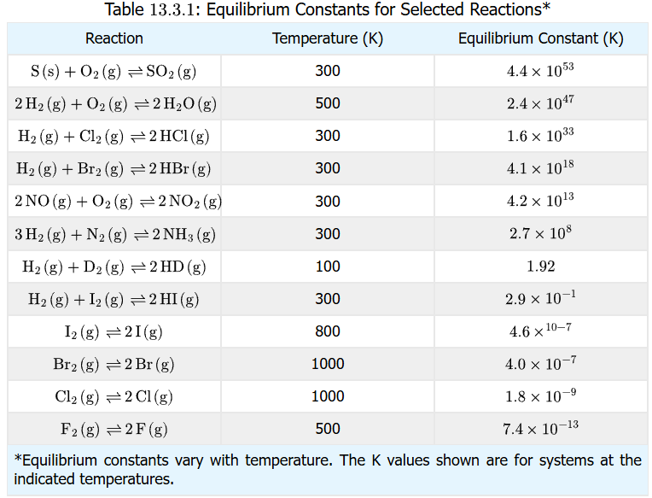
Meaning of Equilibrium Constant
Base on the definition of the equilibrium constant, it can be inferred that a K > 10³ would indicate that the products are highly favored to the reactants in a reaction that is reversible
The formation of HCl (g) from H₂ (g) + Cl₂ (g) has a K ~ 10³³ at room temperature (300 K): Cl₂ is a very good oxidizer and H₂ a very good reducer
By contrast with K < 10^{–3}, the reactants are highly favored

Slide 23
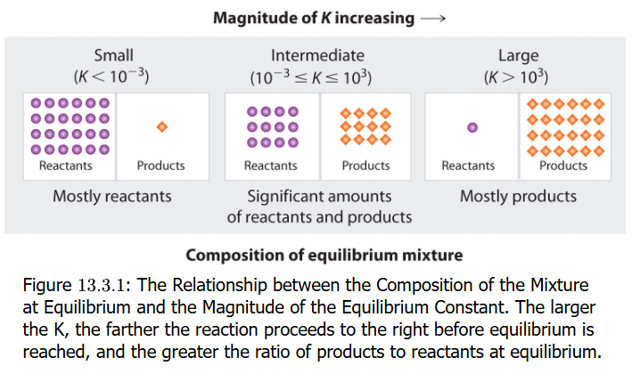
Meaning of Range of K
Practical meaning of the equilibrium constant K is to indicate whether a reaction at the particular temperature and some other conditions will favor reactants not forming products (K < 10⁻³), or the reaction going to completion to products (K > 10³), or an equilibrium reached where there is an even mixture of reactants and products (10⁻³ ≤ K ≤ 10³)

Slide 24

Example: Meaning of Range of K
Recall the reactions: $\left[colorless\right] N2O4 \left(g\right)⇌2 NO2 \left(g\right) \text{[}\text{red}\text{−}\text{brown}\text{]}$
Here is the table of K values for that reaction to emphasize the point
Temperature T | K_{p} | Shift in Equilibrium | Observation
100°C (~373 K) | 1.3 × 10⁶ | product NO₂ strongly favored | relatively dark brown
25°C (298 K) | ~58 | N₂O₄ favored | brown
0°C (273 K) | 0.113-0.142 | both significantly present | pale brown or nearly colorless
–78°C (195 K) | 0.066 | reactant N₂O₄ favored | colorless

Slide 25

Practice: Equilibrium Constant Expression
Write the equilibrium constant expression for the balanced reactions (chemical equations)
N₂ (g) + 3 H₂ (g) $⇌$ 2 NH₃ (g)
$$\frac{\left[NH3\right]2}{\left[N2\right]\left[H2\right]3}$$
CO (g) + 1/2 O₂ (g) $⇌$ CO₂ (g)
$$\frac{\left[CO2\right]}{\left[CO\right]\left[O2\right]1/2}$$
2 CO₂ (g) $⇌$ 2 CO (g) + O₂ (g)
$$\frac{\left[CO\right]2[O2]}{\left[CO2\right]2}$$

Slide 26

Practice: Equilibrium Constant
Write the equilibrium constant (not the equilibrium constant expression) for the balanced reactions (chemical equations)
N₂O (g) $⇌$ N₂ (g) + 1/2 O₂ (g)
$$K=\frac{\left[N2\right]{\left[O2\right]}^{1/2}}{\left[N2O\right]}$$
2 C₈H₁₈ (g) + 25 O₂ (g) $⇌$ 16 CO₂ (g) + 18 H₂O (g)
$$K=\frac{\left[CO2\right]16\left[H2O\right]18}{\left[C8H18\right]2\left[O2\right]25}$$
H₂ (g) + I₂ (g) $⇌$ 2 HI (g)
$$K=\frac{\left[HI\right]2}{\left[H2\right]\left[I2\right]}$$

Slide 27

Practice: Predicting What Predominates
Predict if a system has only products, only reactants, or appreciable amounts of reactants and products
H₂ (g) + I₂ (g) $⇌$ 2 HI (g) K = 54 (at T = 700 K)
Will substantially have mix of products and reactants
2 CO₂ (g) $⇌$ 2 CO (g) + O₂ (g) K = 3.1 × 10⁻¹⁸ (at T = 1200K)
Strongly favors reactant formation and little products
PCl₅ (g) $⇌$ PCl₃ (g) + Cl₂ (g) K = 97 (at T = 613 K)
Substantial presence of both reactants and products
2 O₃ (g) $⇌$ 3 O₂ (g) K = 5.9 × 10⁵⁵ (at T = 298 K)
Favors products, forward reaction to completion

Slide 28
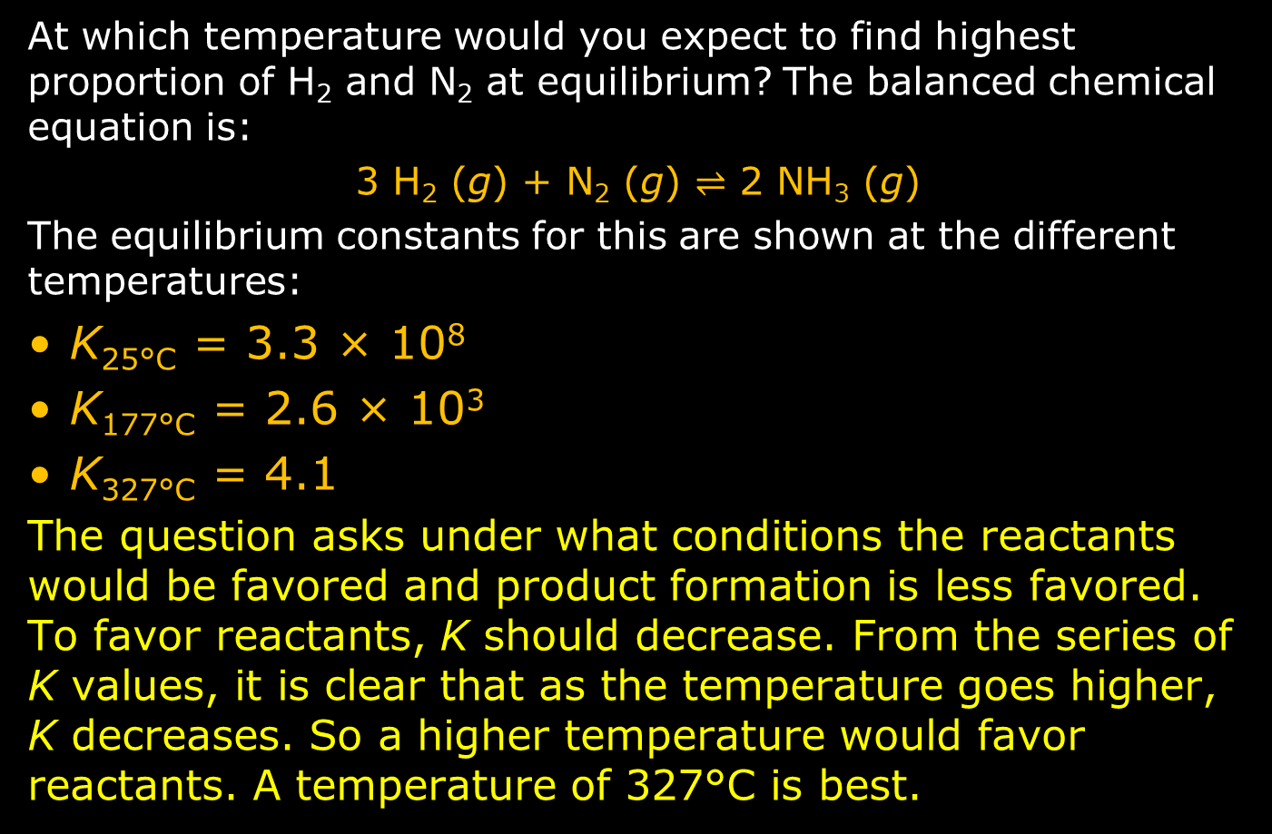
Practice: Temperature and K
At which temperature would you expect to find highest proportion of H₂ and N₂ at equilibrium? The balanced chemical equation is:
3 H₂ (g) + N₂ (g) $⇌$ 2 NH₃ (g)
The equilibrium constants for this are shown at the different temperatures:
K_{25°C} = 3.3 × 10⁸
K_{177°C} = 2.6 × 10³
K_{327°C} = 4.1
The question asks under what conditions the reactants would be favored and product formation is less favored. To favor reactants, K should decrease. From the series of K values, it is clear that as the temperature goes higher, K decreases. So a higher temperature would favor reactants. A temperature of 327°C is best.

Slide 29
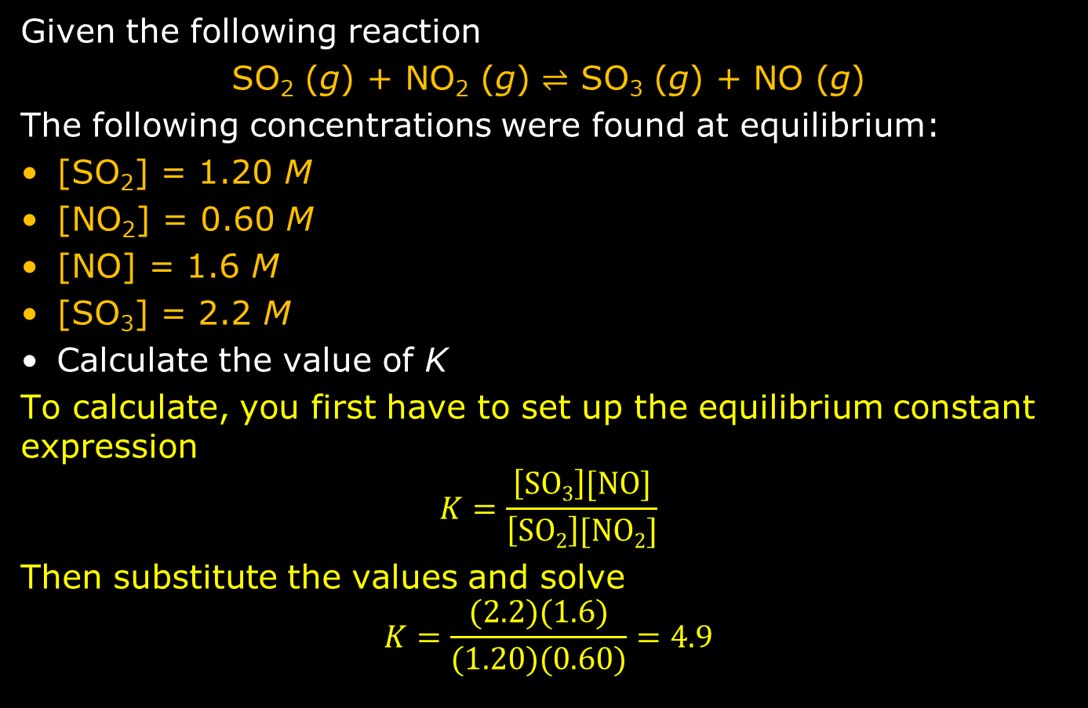
Practice: Calculating K
Given the following reaction
SO₂ (g) + NO₂ (g) $⇌$ SO₃ (g) + NO (g)
The following concentrations were found at equilibrium:
[SO₂] = 1.20 M
[NO₂] = 0.60 M
[NO] = 1.6 M
[SO₃] = 2.2 M
Calculate the value of K
To calculate, you first have to set up the equilibrium constant expression
$$K=\frac{\left[SO3\right][NO]}{\left[SO2\right][NO2]}$$
Then substitute the values and solve
$$K=\frac{(2.2)(1.6)}{(1.20)(0.60)}=4.9$$

Slide 30
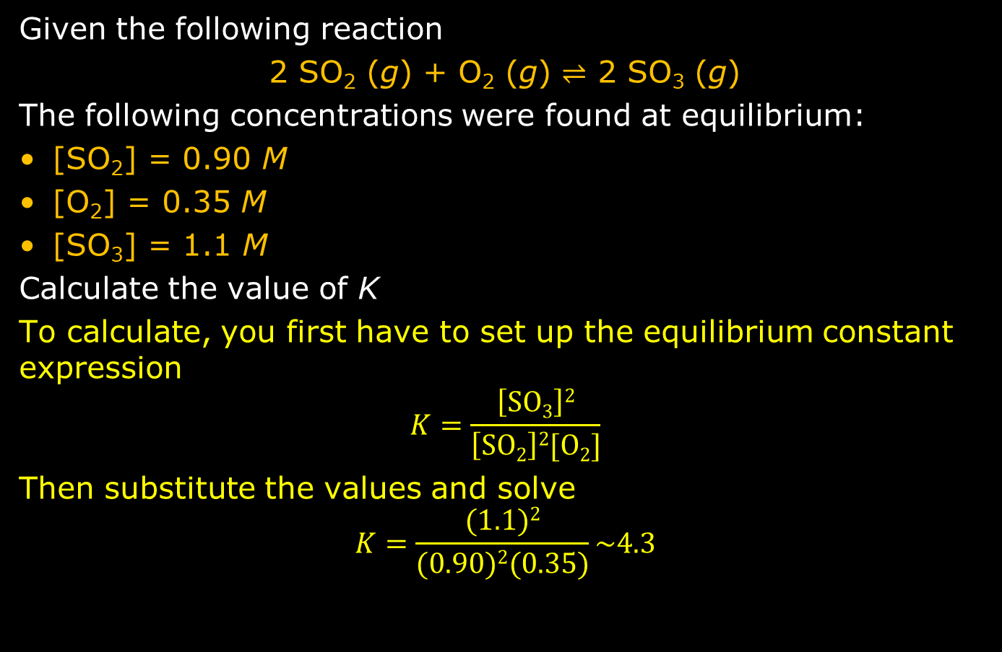
Practice: Calculating K
Given the following reaction
2 SO₂ (g) + O₂ (g) $⇌$ 2 SO₃ (g)
The following concentrations were found at equilibrium:
[SO₂] = 0.90 M
[O₂] = 0.35 M
[SO₃] = 1.1 M
Calculate the value of K
To calculate, you first have to set up the equilibrium constant expression
$$K=\frac{\left[SO3\right]2}{\left[SO2\right]2[O2]}$$
Then substitute the values and solve
$$K=\frac{(1.1)2}{(0.90)2(0.35)}\sim 4.3$$

Slide 31
Notation of Temperature on K
It should re-emphasized that K is temperature-dependent
Because of this, K is often specified with a temperature that can be in Kelvin or Celsius
It may be specified as a subscript or in parenthesis
K_{298K}
K(700K)
K_{25°C}
K_{c}(150°C) equilibrium of concentrations
K_{p}(500K) equilibrium of partial pressures of gases

Slide 32
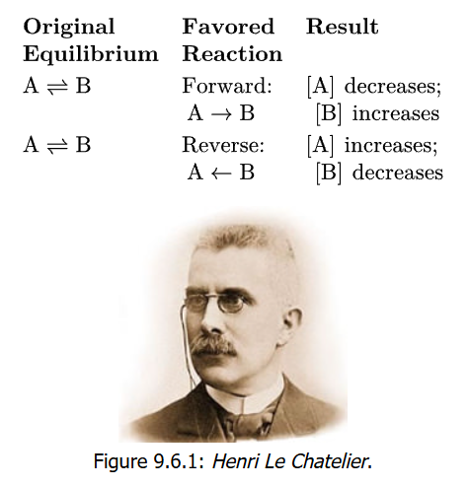
Le Chatelier’s Principle
1884: Le Chatelier reports that when a system at equilibrium is disturbed/stressed, the system will respond/adjust to restore the equilibrium
Stresses/disturbances include
Changing concentrations of reactants and/or products such as adding more or removing some of a reactant or product
Changing the temperature of the system: this changes equilibrium constant K
Changing the pressure in the system: this can affect partial pressures of gases that are reactants and/or products. It can also effect the enthalpy ΔH that controls the PE vs reaction progress plot

Slide 33
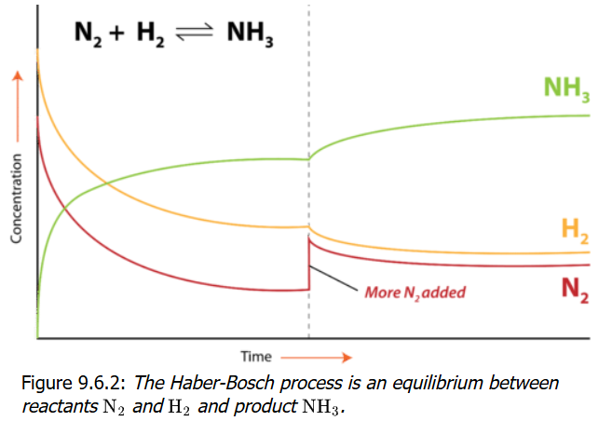

Concentration “Stress”
Effective illustration is production of ammonia by Haber-Bosch process
N₂ (g) + 3 H₂ (g) $⇌$ 2 NH₃ (g)
If more N₂ added, forward reaction favored
More product is formed, and the other reactant H2 is additionally consumed (see plot)

Slide 34
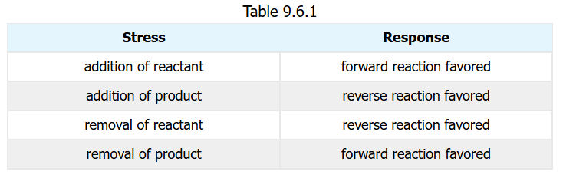

Concentration “Stress”
This principle makes it possibly to predict the shift of the reaction—forward or reverse—occurs to make an adjustment to restore equilibrium
Predict what happens with the N₂ + 3 H₂ $⇌$ 2 NH₃
H₂ is added
More H₂ reactant, shift to right to products (forward reaction)
NH₃ is added
More NH₃ product, shift to left to reactants (reverse reaction)
NH₃ is removed
Less NH₃ product, shift to right to products (forward reaction)

Slide 35

Practice: Concentration “Stress”
Predict what happens with the following reaction
CO (g) + Br₂ (g) $⇌$ COBr₂ (g)
Br₂ is removed
Less Br₂ reactant, shift to left to reactants (reverse reaction)
COBr₂ is added
More CoBr₂ product, also shift to left to reactants (reverse reaction)

Slide 36

Temperature “Stress”
Returning to the ammonia production, the thermochemical equation is shown
recall it includes a positive or negative energy value: if positive, heat is released (exothermic), if negative, heat/energy is required (endothermic)
The forward reaction is positive so heat released
The reverse reaction therefore requires energy
N₂ (g) + 3 H₂ (g) $⇌$ 2 NH₃ (g) + 91 kJ
What effect temperature?
Reducing temperature has effect of removing energy/heat, which favors products
Adding heat (raising temperature) would favor going in reverse reaction, forming reactants

Slide 37
Temperature “Stress”
Raising temperature has effect of favoring the direction of the reaction that requires heat/energy to form the compounds
If the direction of a reaction is endothermic (requires heat/energy), raising temperature pushes the reaction in the endothermic direction
The logic applies that if a reaction is exothermic (releases heat/energy), then lowering temperature should favor the reaction towards the exothermic direction

Slide 38
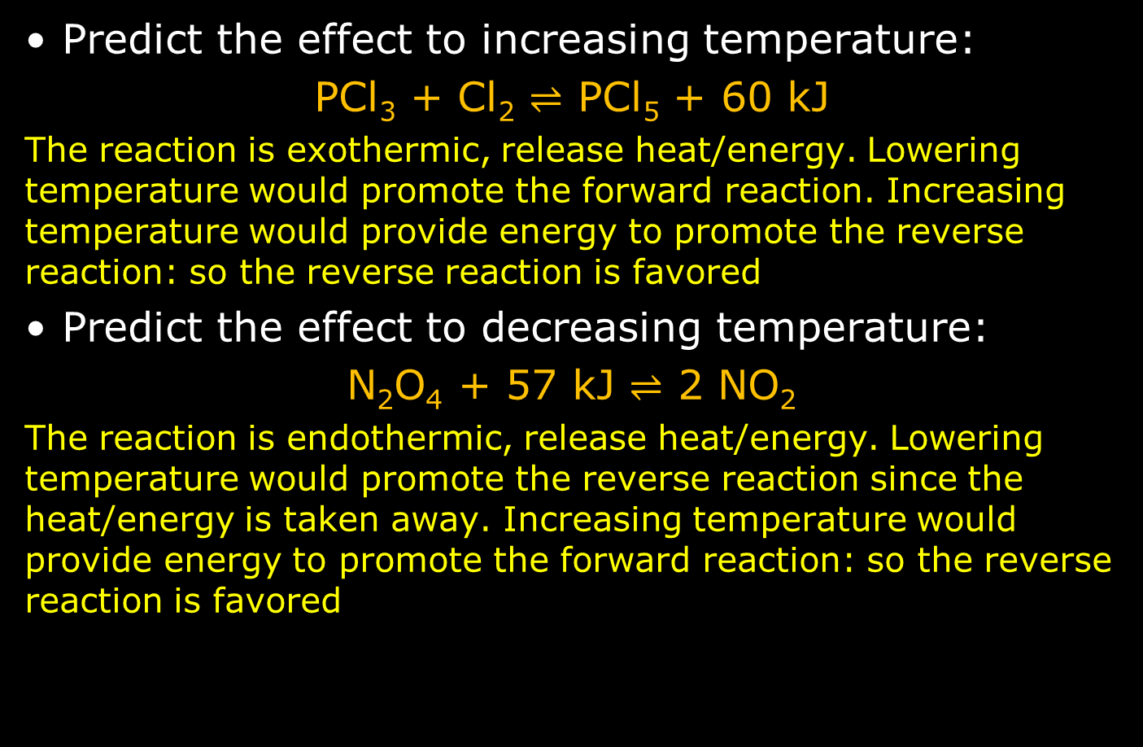
Practice: Temperature “Stress”
Predict the effect to increasing temperature:
PCl₃ + Cl₂ $⇌$ PCl₅ + 60 kJ
The reaction is exothermic, release heat/energy. Lowering temperature would promote the forward reaction. Increasing temperature would provide energy to promote the reverse reaction: so the reverse reaction is favored
Predict the effect to decreasing temperature:
N₂O₄ + 57 kJ $⇌$ 2 NO₂
The reaction is endothermic, release heat/energy. Lowering temperature would promote the reverse reaction since the heat/energy is taken away. Increasing temperature would provide energy to promote the forward reaction: so the reverse reaction is favored

Slide 39
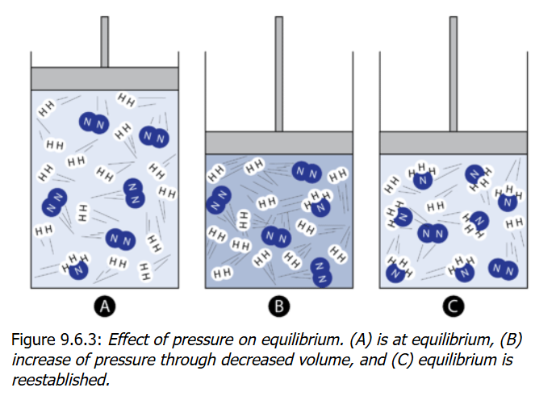

Pressure “Stress”
When the reactants and products are gases, changes in the partial pressure of any component of the system would require restoration of the equilibrium
This would not be true for solids and liquids
A in figure shows system at equilibrium
In B, pressure is increased (out of equilibrium)
In C, equilibrium restored
What happened?
N₂ (g) + 3 H₂ (g) $⇌$ 2 NH₃ (g)
With increased pressure, whichever side has fewer moles of all gases will be favored. 4 moles of gas on reactants form 2 moles of gas in products, so higher pressure pushes to 2 moles

Slide 40
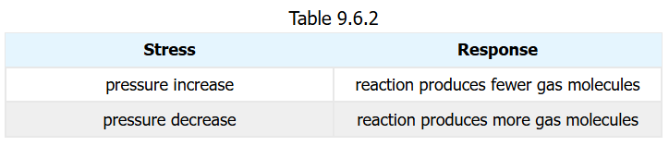
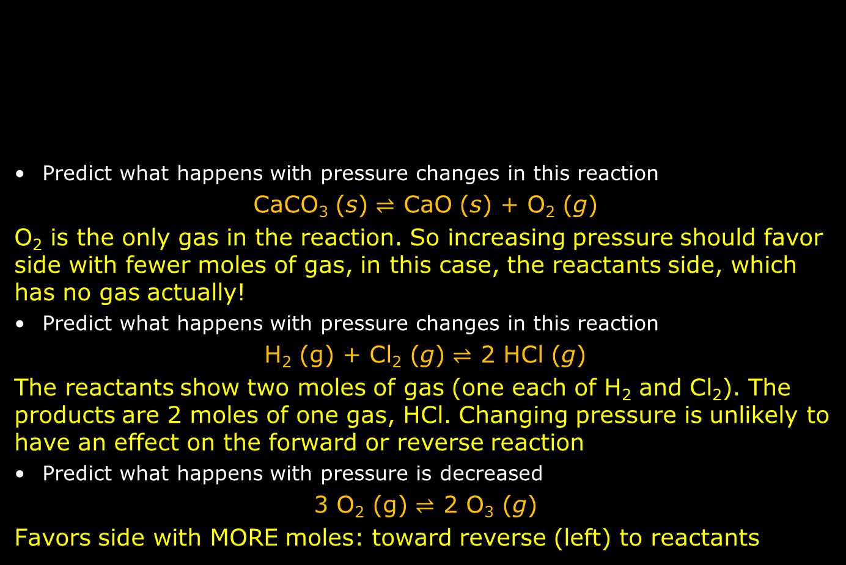
Practice: Pressure “Stress”
Predict what happens with pressure changes in this reaction
CaCO₃ (s) $⇌$ CaO (s) + O₂ (g)
O₂ is the only gas in the reaction. So increasing pressure should favor side with fewer moles of gas, in this case, the reactants side, which has no gas actually!
Predict what happens with pressure changes in this reaction
H₂ (g) + Cl₂ (g) $⇌$ 2 HCl (g)
The reactants show two moles of gas (one each of H₂ and Cl₂). The products are 2 moles of one gas, HCl. Changing pressure is unlikely to have an effect on the forward or reverse reaction
Predict what happens with pressure is decreased
3 O₂ (g) $⇌$ 2 O₃ (g)
Favors side with MORE moles: toward reverse (left) to reactants

Slide 41
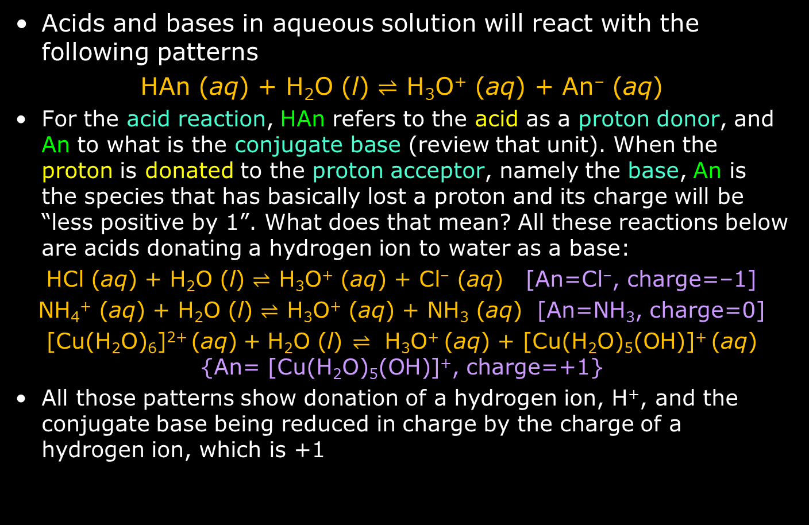
Patterns in Acid-Base Reactions
Acids and bases in aqueous solution will react with the following patterns
HAn (aq) + H₂O (l) $⇌$ H₃O⁺ (aq) + An– (aq)
For the acid reaction, HAn refers to the acid as a proton donor, and An to what is the conjugate base (review that unit). When the proton is donated to the proton acceptor, namely the base, An is the species that has basically lost a proton and its charge will be “less positive by 1”. What does that mean? All these reactions below are acids donating a hydrogen ion to water as a base:
HCl (aq) + H₂O (l) $⇌$ H₃O⁺ (aq) + Cl– (aq) [An=Cl–, charge=–1]
NH₄⁺ (aq) + H₂O (l) $⇌$ H₃O⁺ (aq) + NH₃ (aq) [An=NH₃, charge=0]
[Cu(H₂O)₆]²⁺ (aq) + H₂O (l) ⇌ H₃O⁺ (aq) + [Cu(H₂O)₅(OH)]⁺ (aq) {An= [Cu(H₂O)₅(OH)]⁺, charge=+1}
All those patterns show donation of a hydrogen ion, H⁺, and the conjugate base being reduced in charge by the charge of a hydrogen ion, which is +1

Slide 42
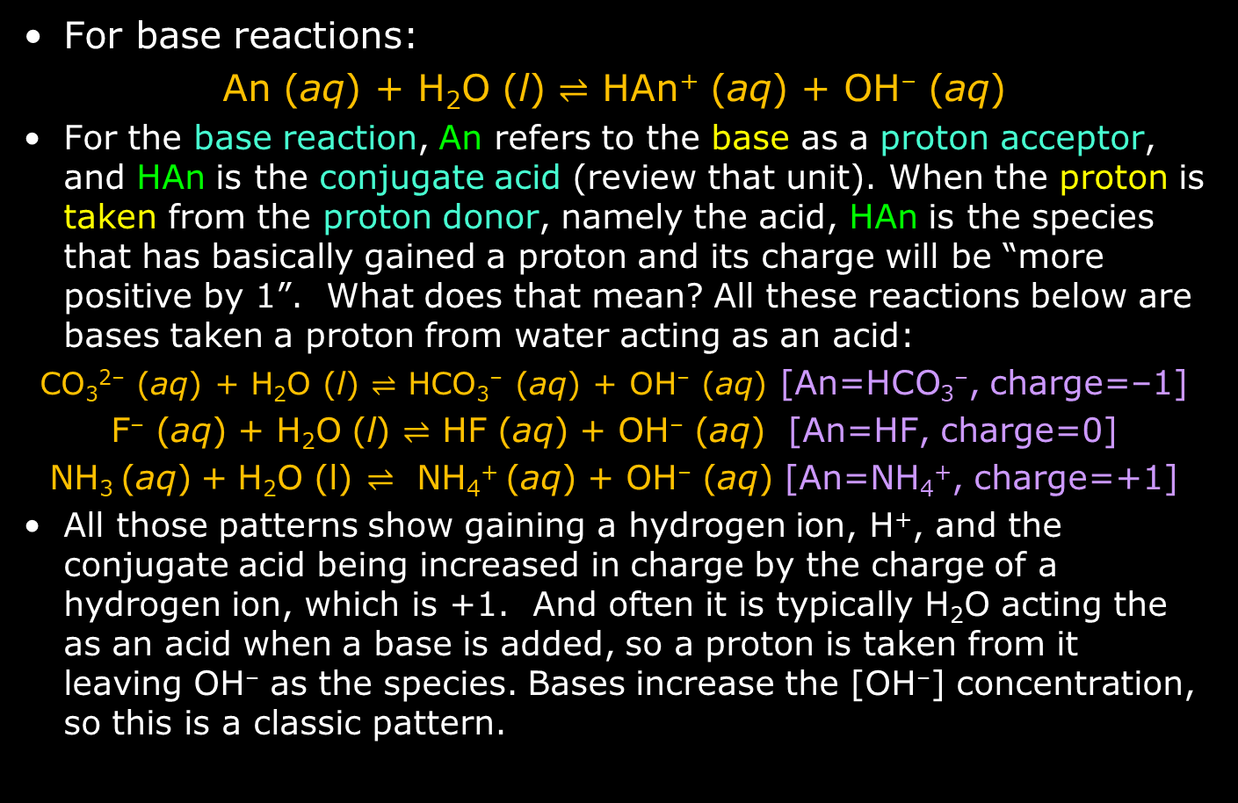
Patterns in Acid-Base Reactions
For base reactions:
An (aq) + H₂O (l) $⇌$ HAn⁺ (aq) + OH– (aq)
For the base reaction, An refers to the base as a proton acceptor, and HAn is the conjugate acid (review that unit). When the proton is taken from the proton donor, namely the acid, HAn is the species that has basically gained a proton and its charge will be “more positive by 1”. What does that mean? All these reactions below are bases taken a proton from water acting as an acid:
CO₃^{2–} (aq) + H₂O (l) $⇌$ HCO₃– (aq) + OH– (aq) [An=HCO₃–, charge=–1]
F– (aq) + H₂O (l) $⇌$ HF (aq) + OH– (aq) [An=HF, charge=0]
NH₃ (aq) + H₂O (l) ⇌ NH₄⁺ (aq) + OH– (aq) [An=NH₄⁺, charge=+1]
All those patterns show gaining a hydrogen ion, H⁺, and the conjugate acid being increased in charge by the charge of a hydrogen ion, which is +1. And often it is typically H₂O acting the as an acid when a base is added, so a proton is taken from it leaving OH– as the species. Bases increase the [OH–] concentration, so this is a classic pattern.

Slide 43

K Expressions for Acids and Bases
Acids and bases in aqueous solution will react with the following patterns
HAn (aq) + H₂O (l) $⇌$ H₃O⁺ (aq) + An– (aq)
Now apply the definition of the equilibrium constant equation to the equilibrium reaction:
$$Ka=\frac{\left[{H3O}^{+}\right][{An}^{–}]}{[HAn]}$$
Two things to note here
The constant K_{a} is called the acid dissociation constant. It is an equilibrium constant like all others, but just specifically indicates with the subscript “a” that it refers to an acid giving its proton (hydrogen ion, H⁺) to a base, typically H₂O (because it’s in aqueous solution), acting as a base [proton acceptor] in the reaction
H₂O (water) is excluded as a reactant in the K_{a} expression as it will not influence the equilibrium. [Recall the condition of excluding compounds in “(l)” state]

Slide 44

K Expressions for Acids and Bases
The K_{a} expression for a strong acid HCl was shown. What about a strong base like NaOH?
An (aq) + H₂O (l) $⇌$ HAn⁺ (aq) + OH– (aq)
Now apply the definition of the equilibrium constant equation to the equilibrium reaction:
$$Kb=\frac{\left[{HAn}^{+}\right][{OH}^{–}]}{[An]}$$
Two things to note here
The constant K_{b} is called the base ionization constant (not base dissociation constant!!) It too is an equilibrium constant like all others, but the subscript “b” that it refers to an acid giving its proton (hydrogen ion, H⁺) to a base, typically H₂O (because it’s in aqueous solution), acting as a base [proton acceptor] in the reaction
H₂O (water) is excluded as a reactant in the K_{b} expression as it will not influence the equilibrium. [Recall the condition of excluding compounds in “(l)” state]

Slide 45
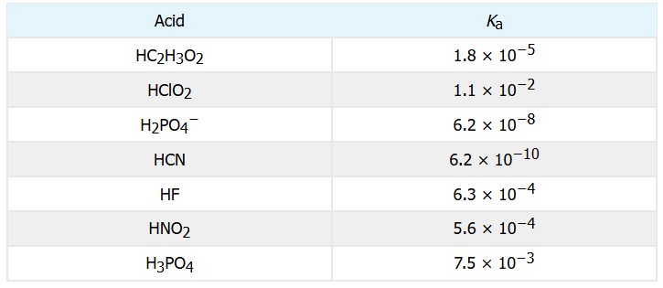

Tying Together Use of Acid-Base K Expressions
The 4 previous slides go into extraordinary detail (that is, with examples) to try to make sense of the textbook’s use of acid and base equilibrium constant expressions
You should be able to apply definition for K expressions for weak acids like those below. The first three are:
CH₃COOH (aq) + H₂O (l) $⇌$ CH₃COO– (aq) + H₃O⁺ (aq)$Ka=\frac{\left[{H3O}^{+}\right][{CH3COO}^{–}]}{[CH3COOH]}=1.8×{10}^{−5}$
HClO₂ (aq) + H₂O (l) $⇌$ ClO₂– (aq) + H₃O⁺ (aq)$Ka=\frac{\left[{H3O}^{+}\right][{ClO2}^{–}]}{[HClO2]}=1.1×{10}^{−2}$
H₂PO₄– (aq) + H₂O (l) $⇌$ HPO₄^{2–} (aq) + H₃O⁺ (aq)$Ka=\frac{\left[{H3O}^{+}\right][{HPO4}^{2–}]}{[{HPO4}^{–}]}=6.2×{10}^{−8}$

Slide 46

Tying Together Use of Acid-Base K Expressions
Another thing you should be able to understand from the equilibrium constants for the weak acids in particular
In the table below, which is the weakest of the weak acids?
Recall that the acid dissociation constant is an equilibrium constant with an expression $Ka=\frac{[Products]}{[Reactants]}$ which is multiplication of product concentrations divided by multiplication reactant concentrations. If the K_{a} is larger, that means the acid is stronger in protonating the other reactant (the proton acceptor). If K_{a} is smaller, the acid is less likely to protonate. The meaning of that is that it would be the weaker of weak acids: less likely to dissociate, less likely to be a proton donor. In that list, that looks like HCN: $HCN+H2O⇌H3O^{+}+{CN}^{–}$

Slide 47

Practice: Equilibrium Equations for K_{a}
Write the chemical equilibrium equation and the K_{a} expression for weak acid HSO₄–
HSO₄– (aq) + H₂O (l) $⇌$ H₃O⁺ (aq) + SO₄^{2–} (aq)
$$Ka=\frac{\left[{H3O}^{+}\right][{SO4}^{2–}]}{[{HSO4}^{–}]}$$
Do the same for the weak acid HPO₄^{2–}
HPO₄^{2–} (aq) + H₂O (l) $⇌$ H₃O⁺ (aq) + PO₄^{3–} (aq)
$$Ka=\frac{\left[{H3O}^{+}\right][{PO4}^{3–}]}{[{HPO4}^{2–}]}$$

Slide 48

Water as Acid & Base: K_{w}=K_{a}K_{b}
Previously we showed the generic equilibrium constant equation for K_{a} and K_{b}. (It can be shown that HAn = HAn⁺ and An– = An as corresponding conjugate acids and bases)
$Ka=\frac{\left[{H3O}^{+}\right][{An}^{–}]}{[HAn]}$, $Kb=\frac{\left[HAn\right][{OH}^{–}]}{[{An}^{–}]}$
Doing some algebra to solve for Han on K_{a} and K_{b},
$$[HAn] =\frac{\left[{H3O}^{+}\right][{An}^{–}]}{Ka}\text{,} \left[HAn\right]=\frac{Kb[{An}^{–}]}{[{OH}^{–}] }$$
And so
$$\frac{\left[{H3O}^{+}\right][{An}^{–}]}{Ka}=\frac{Kb[{An}^{–}]}{[{OH}^{–}] }$$
Getting the constants on one side of the equation and canceling out [An–]:
$$\left[{H3O}^{+}\right][{OH}^{–}]=KaKb$$
Since K_{w} = [H₃O⁺][OH–], therefore K_{w} = K_{a}K_{b}
And since K_{w} = 1.0 × 10^{–14}, then K_{a}K_{b} = 1.0 × 10^{–14}

Slide 49
Equilibrium Reaction of Precipitation
Up to this point, precipitation reactions usually involving some metal cation (M⁺) and a nonmetal monatomic or polyatomic anion (X–) would be described by this reaction pattern:
M⁺ (aq) + X– (aq) → MX (s)
But precipitation reactions are not actually one way—towards the formation of a solid precipitate
Just like many chemical reactions, they are two-way, reversible: if the well-known precipitant silver chloride (AgCl) is spooned out as a solid into a beaker of water, the aqueous solution will have detectable levels of Ag⁺ and Cl– ions
It’s all about a range of solubility, from very low to super high (total dissolution)

Slide 50

The Solubility Product K_{sp}
The precipitation reaction is properly written with the equilibrium character
M⁺ (aq) + X– (aq) $⇌$ MX (s)
And when written this way
M_{n}X_{y} (s) $⇌$n M^{y+} (aq) + y X^{n–} (aq)
the equilibrium equation is
$$Ksp={\left[M^{y+}\right]}^{n}{[X^{n–}]}^{y}$$
Notes
K_{sp} is the solubility product constant
This template/pattern covers all conditions for the charge state (±1, ±2, etc) of M and X and their coefficients
Always remember that for all equilibrium constant expressions that coefficients in the K equation are shown as exponents to the concentration of the species
Reactants are shown in denominator of K equations, but since reactant MX is a solid, it will not be in K_{sp} equations typically

Slide 51
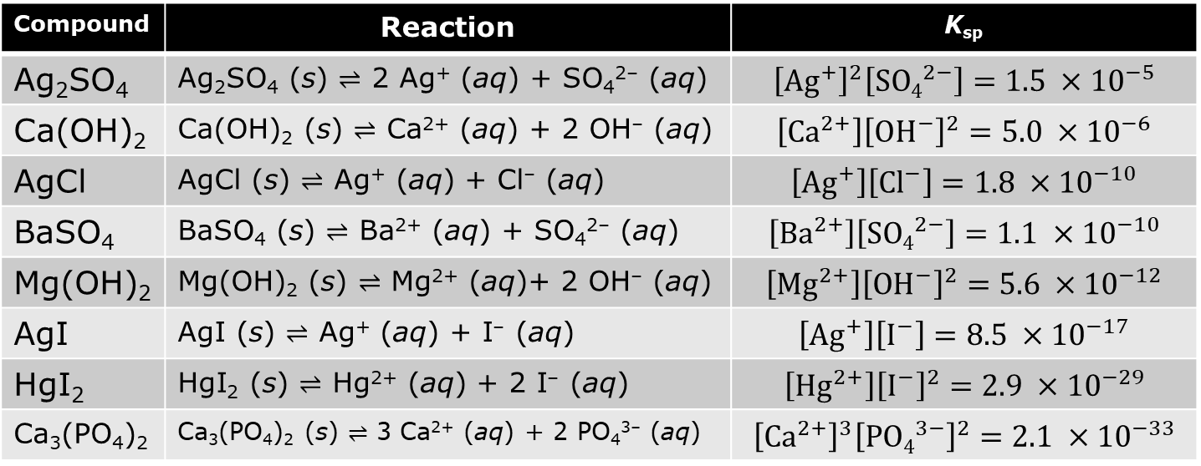

Example K_{sp} Values
The silver chloride solubility chemical reaction is this
AgCl (s) $⇌$ Ag⁺ (aq) + Cl– (aq)
Table below the reactions and equilibrium constant equations
Compound | Reaction | K_{sp}
Ag₂SO₄ | Ag₂SO₄ (s) $⇌$ 2 Ag⁺ (aq) + SO₄^{2–} (aq) | $${\left[{Ag}^{+}\right]}^{2}\left[{SO4}^{2−}\right]=1.5 ×{10}^{−5}$$
Ca(OH)₂ | Ca(OH)₂ (s) $⇌$ Ca²⁺ (aq) + 2 OH– (aq) | $$\left[{Ca}^{2+}\right]{\left[{OH}^{−}\right]}^{2}=5.0 ×{10}^{−6}$$
AgCl | AgCl (s) $⇌$ Ag⁺ (aq) + Cl– (aq) | $$\left[{Ag}^{+}\right]\left[{Cl}^{−}\right]=1.8 ×{10}^{−10}$$
BaSO₄ | BaSO₄ (s) $⇌$ Ba²⁺ (aq) + SO₄^{2–} (aq) | $$\left[{Ba}^{2+}\right]\left[{SO4}^{2−}\right]=1.1 ×{10}^{−10}$$
Mg(OH)₂ | Mg(OH)₂ (s) $⇌$ Mg²⁺ (aq)+ 2 OH– (aq) | $$\left[{Mg}^{2+}\right]{\left[{OH}^{−}\right]}^{2}=5.6 ×{10}^{−12}$$
AgI | AgI (s) $⇌$ Ag⁺ (aq) + I– (aq) | $$\left[{Ag}^{+}\right]\left[I^{−}\right]=8.5 ×{10}^{−17}$$
HgI₂ | HgI₂ (s) $⇌$ Hg²⁺ (aq) + 2 I– (aq) | $$\left[{Hg}^{2+}\right]{\left[I^{−}\right]}^{2}=2.9 ×{10}^{−29}$$
Ca₃(PO₄)₂ | Ca₃(PO₄)₂ (s) $⇌$ 3 Ca²⁺ (aq) + 2 PO₄^{3–} (aq) | $${\left[{Ca}^{2+}\right]}^{3}{\left[{PO4}^{3−}\right]}^{2}=2.1 ×{10}^{−33}$$

